Slide 1
Crime Rates and Unemployment Level
An exploration of the relationship between reported crime in the US and unemployment Level
By Jeremy Campbell, Eleni Lazaridou, and Bryan Epperson

Slide 2


Introduction: What is crime and unemployment rate?
Notes:
Who knows someone who has lost their job as a result of the pandemic? Our hypothesis is that we believe that there is a positive relationship between crime rate in the United States and unemployment. This topic became an interest to our team based on the current state of our economy in the US. As the pandemic rages, more and more jobs are being shut down and millions of people are being affected. I’m sure some of you can identify someone you know right now that has been affected by the pandemic.

Slide 3

Business Context
Poverty and Unemployment: Related and detrimental in a business setting.
Notes:
In business we talk of opportunity costs, which represent the risks and benefits associated with making a decision. When an individual loses their job, like in this pandemic economy, they experience a lot of distress and understandably so. Financial security is lost, and they begin weighing their options.From Business insider, Minimum wage jobs are not necessarily gainful employment, as they cannot afford rent on a full time basis. (Link) So because of this, the opportunity costs of turning to crime severely decrease, because the bills do not care if you are employed or not.
Assuming our hypothesis is true, Unemployment and crime rate do not help businesses. You can’t hire someone that is sitting in jail trying to survive from being unemployed.
So businesses can do their part by offering competitive compensation packages that would entice people to increase the opportunity cost of crime, in favor of what they now consider gainful employment.

Slide 4

Research Questions
Notes:
Now with our hypothesis and how businesses can be affected by unemployment and crime rate, we move to our research questions:
Does the data have a sufficient size and credibility fit for data analysis?
What is the total crime rate in the US?
What is the total Unemployment rate in the US?
Which states in the United states have the highest crime rates?
What year between 1960-2014 had the highest violent crimes, and why?
How does unemployment level affect crime rate?
How does poverty level affect crime rate?
What can we learn from the relationship between unemployment rate and crime rate.

Slide 5

Data Cleaning
Notes:
For our datasets it was necessary to strip out irrelevant information to assist in analyzing our data. We deleted irrelevant information such as info on 2015, and percentage difference in crime rate from the crime rates excel document. We also had to delete spaces in the unemployment rate of the 50 states for our merge in the data exploration stage, which cause us a lot of trouble. If you wish to have access to any of the data that we used in the upcoming analysis, feel free to let us know.

Slide 6

Data Exploration
'Crime_US_total.xlsx'
'Poverty.xlsx'
'Crime rate 2014.xlsx'
Unemployment Rate 2014 by state.xlsx
csvData.csv
Total number of violent crimes compared to the total poverty rate in the US
Crime Rate compared to the unemployment rates for all the states for the year of 2014
Notes:
First, we imported five datasets as data frames. Then we merged the first two and the last three and created two separate data frames. The first one shows the total number of violent crimes in the United States per year for 1960- 2014. Violent Crimes include homicides, assaults, rapes, robberies, abductions, and harassment. The second one shows the poverty rate for each year 1990-2014. After merging these two, we got a data frame representing the total number of violent crimes compared to the total poverty rate. The third one shows the crime rate of each state of the year 2014. The fourth one shows the Unemployment rate of each state for the year 2014. On the last one, we get the state names and their codes and abbreviation. After merging these three, we got a data frame representing Crime Rate compared to all the state's unemployment rates for 2014.

Slide 7
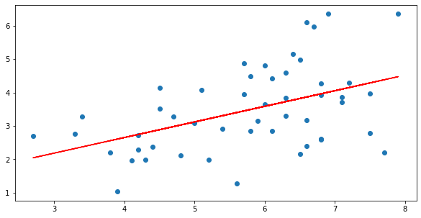
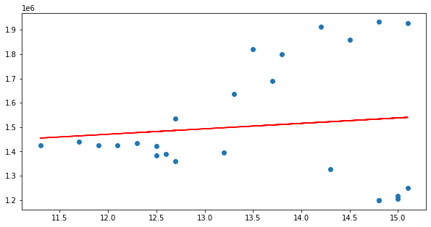
Analysis
Violent Crime Rate
Linear Regression on 2 Data frames:
1) Crime vs Unemployment
2) Crime vs Poverty
Unemployment Rate
Violent Crime Rate
Poverty Level
Notes:
After exploring the data, we moved to the part when we have to analyze them. We created a linear regression between the unemployment and crime rate, and the poverty and crime rate. As we can see, both have a positive correlation, but specifically, the second one has a stronger positive correlation.

Slide 8
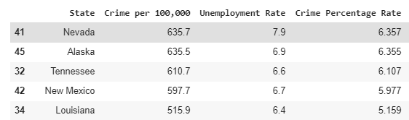

Analysis
Notes:
We also found the 10 States with the highest crime rate for 2014. For the top 5, we have Nevada, Alaska, Tennessee, New Mexico, and Louisiana. In addition to that, based on the states' crime rate and unemployment rate, we calculated an approximation of the crime and unemployment rate for 2014. Surprisingly, our estimates were close to the actual values.

Slide 9
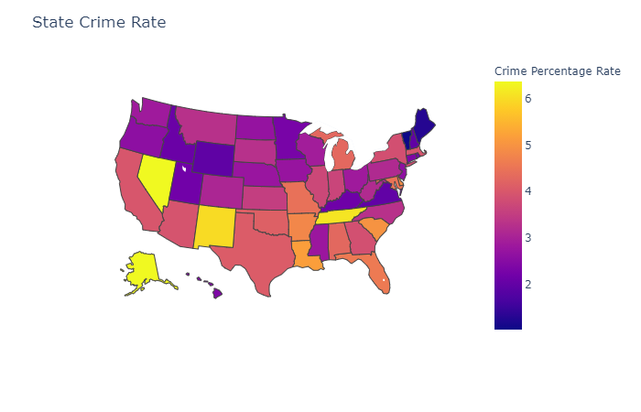
Data Visualization
Notes:
Next, we can show a representation of the Crime rates around the United States. Yellow shows the highest crime rate, and dark blue shows the lowest crime rate. So, you do not want to move to TN.

Slide 10
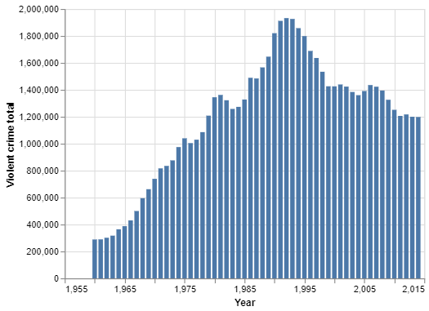
Summarized Results of the Analysis Part 1: Total Violent Crime in the US
Notes:
Does the data have a sufficient size and credibility fit for data analysis? Yes, because the dataset has at least 30 samples within it and are from credible government websites.
What is the total crime rate in the US? The total crime per 100,000 people in the United States is 17329.1, giving an estimate of 3.5%.
What is the total Unemployment rate in the US We got that the unemployment rate in the United States is 5.74%
Which states in the United states have the highest crime rates? The top 3 states with the highest crime rate are: Nevada, Alaska, Tennessee.
What year between 1960-2014 had the highest violent crimes, and why? The year with the highest crime rate is 1992, because most states are lacking resources and police officers. According to the Clinton and Gore historical website, widespread instances of gun violence and lack of the aforementioned resources and common sense gun laws triggered contributed in the skyrocketing of crime rate for the US. The Clinto administration enacted several policies to help reduce the level of crime and restrict access to high powered arms. Reference Link
How does unemployment level affect crime rate? We found out that there is a positive correlation between the unemployment rate and the crime rate in the year 2014, for the 50 states. Therefore, we can conclude that unemployment affects the crime rate.
How does poverty level affect crime rate? Poverty affects the Crime rate ...
What can we learn from the relationship between unemployment rate and crime rate. Between unemployment and crime rate we can see that states with a high unemployment rate have a higher crime rate.

Slide 11
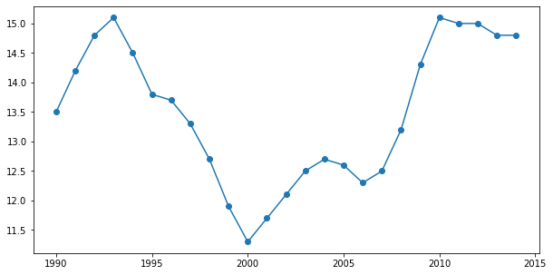
Summarized Results of the Analysis Part 2: Poverty Rate
Poverty Rate
Year

Slide 12
Summarized Results of the Analysis Part 3: Linear regression models
Violent Crime Rate
Violent Crime Rate
Unemployment Rate
Poverty Level
Correlation between Crime rate and unemployment rate
Correlation between Crime rate and Poverty Rate

Slide 13

Conclusion
That our hypothesis was correct about Crime rate and unemployment. The higher the unemployment in a state the higher the crime rate.
Notes:
That violent crime rate from 1960 - 1992 was on the rise then from 1993 to 2014 violent crime began to decrease and then even out.
The south and midwest region of the US have higher crime rates than other regions.
Poverty from 1994 to 2000 was dropping and then from 2001 onwards poverty starts to rise agai

Slide 14

So, what did we learn?
Gather, Clean, Analyze and Visualize data.
Work as a team to accomplish our goals
Gain Insights from data
Process of Data Analysis

Slide 15
Web Resources Used
Ahmed, B., Abdullah, U., & Akhtar, S. (2019). The Relationship between Education and Crime Analysis (1991-2016): A Case Study of Pakistan. International Journal of Humanities, Arts & Social Sciences, 5(5), 171–182. https://doi-org.berea.idm.oclc.org/10.20469/ijhss.5.20001-5
Education as crime prevention. (1998). Spectrum: Journal of State Government, 71(1), 26.
Bureau, U. C. (n.d.). Education. The United States Census Bureau. Retrieved September 29, 2020, from https://www.census.gov/topics/education.html

Slide 16
Web resources part 2
Chicago poverty and crime | City of Chicago | Data Portal. (2020). Chicago. Retrieved September 29, 2020, from https://data.cityofchicago.org/Health-Human-Services/Chicago-poverty-and-crime/fwns-pcmk/data
Crime in the US: All 50 states ranked by murder, violent crime rates. (January 13th, 2020). Retrieved September 29, 2020, from https://www.usatoday.com/story/money/2020/01/13/most-dangerous-states-in-america-violent-crime-murder-rate/40968963/
DataUNODC |. (n.d.). Retrieved September 29, 2020, from https://dataunodc.un.org/
Education and Crime—Criminal Justice—IResearchNet. (2020). Criminal Justice. Retrieved September 29, 2020, from https://criminal-justice.iresearchnet.com/crime/education-and-crime/4/

Slide 17
Web resources used part 3
Harlow, C. W. (April 15th, 2003.). Education and Correctional Populations. 12.
Perry, S. (2020). Tribal Crime Data-Collection Activities, 2020. 9.
Unemployment Rates for States. (September 18th, 2020). Retrieved September 29, 2020, from https://www.bls.gov/web/laus/laumstrk.htm
Uniform Crime Reporting Statistics. (n.d.). Retrieved September 29, 2020, from https://www.ucrdatatool.gov/Search/Crime/State/RunCrimeOneYearofData.cfm

Slide 18
Web resources used part 4
United States Department Of Justice. Office Of Justice Programs. Bureau Of Justice Statistics. (1999). Survey of Adults on Probation, 1995: [United States]: Version 1 [Data set]. ICPSR - Interuniversity Consortium for Political and Social Research. https://doi.org/10.3886/ICPSR02039.V1
The Clinton Presidency: Lowest Crime Rates in a Generation. (n.d.). Retrieved October 1, 2020, from https://clintonwhitehouse5.archives.gov/WH/Accomplishments/eightyears-06.html

Slide 19
Pictures Used
Link
Link
Link
Link

